Slide 1


CSE 431
NATURAL LANGUAGE PROCESSING
SENTIMENT CLASSIFICATION IN BANGLA TEXTUAL CONTENT: A COMPARATIVE STUDY
Presented by: Sayma Akter Lubna
ID : 20301450
Sec: 01

Slide 2
Accordingly, this huge digital content leads the analysts to examine and comprehend the opinion with the goal that it can help in direction. it is restricted to the English language yet not different dialects like Bangla.
In our day to day routines, the tremendous utilization of web-based entertainment has been expanded which make people to share opinion on the platforms
Introduction
This is on the grounds that for Bangla there are not many freely accessible datasets and conflicting benchmarks because of absence of train/test split. Sentiment anal﻿ysis is one of the well researched areas in NLP. The datasets were analyzed to get a better understanding of lexicons that reflect both positive and negative sentiments.
this paper presents a comprehensive study of sentiment analysis in the context of the Bangla language, offering valuable insights into the performance of classical and deep learning algorithms.

Slide 3

Objective/Motivation
To address the limitation, the study includes comparative study between public Bangla sentiments dataset and built house datasets- training complexity, model performance, and implication in real deployment.
The goal is to get a superior comprehension of the trade­off between computational interest and execution and for Bangla, utilizing numerous openly accessible feeling marked datasets, there were planned classifiers worked by utilizing classical and deep learning algorithms.

Slide 4
Paperwork
Already there have been some investigations of opinion examination for the Bangla language and Part­of­Speech (PoS)tagging, stemming, SentiWordNet, and negative word list was utilized. Works like a semi­supervised procedure were proposed for Bangla feeling examination by utilizing Twitter posts with a precision of 93% by utilizing unigrams with emojis.
Yet, this work varies from past works such that a similar examination with various datasets were given and classical and deep learning algorithms with transformer models ­, for example, BERT was utilized.

Slide 5
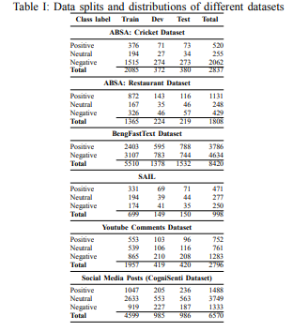
Used Data & Methodologies
The dataset used are:
a) Data description:
Sentiment Analysis in Indian Languages (SAIL) Dataset
ABSA Dataset
YouTube Comments Dataset
BengFastText Dataset
Social Media Posts (CogniSenti Dataset)

Slide 6
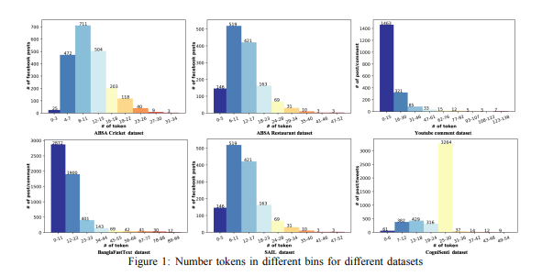
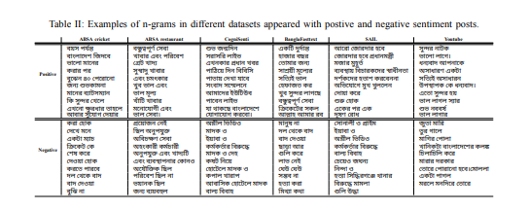
b) Data analysis:
For understanding the characteristics of the datasets, firstly, the discussion of the the datasets in terms of token length is done, then the data were analyzed by positive/negative lexical n grams in individual datasets and in combination.
Token length distribution
Class­wise Lexical n­gram Discrimination

Slide 7
Methodologies
Random Forest(RF)
Support Vector Machines (SVM)
As Classical algorithms, used-
CNN
Fast-Text
transformers based models such as BERT
DistilBERT
XLM­RoBERTa
As Deep Learning Algorithms -
Before training a classifier, filtering and cleaning the data was done.
A multilingual version of the models was used for all the models and the fine­tuning procedure using a task-specific layer on top of the transformers network was followed.

Slide 8
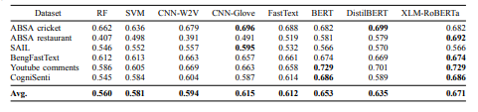
Results and Discussion
From the table, we observe that among the classical algorithms the performance of SVM is better than RF except for ABSA cricket dataset where RF is 2.6% higher. As from the table that it is seen that there is a consistent improvement with deep learning models.
Thus, transformer-based models which have not been explored previously for Bangla, perform better than all other models.
Classification results using RF, SVM, CNN, FastText, BERT, DistilBERT and RoBERTa.
Best results are highlighted with bold form

Slide 9

Investigation of the datasets to decipher lexical substance's separating angles for positive and negative opinion was done
Conclusion
Examination shows a logical, significant, and clear contrast between the classes.
The presentation of deep learning algorithms is nearly better contrasted with classical algorithms and this improvement happened on account of expanded asset and time complexity.
Comparison of results with previous results was not possible as the official splits in various datasets are unavailable.

Slide 10
1.
The language's rich morphology, idiomatic expressions, different dialects and nuances, and cultural context can lead to difficulties in accurately capturing sentiment which are not included in the study.
Limitation
2.
Sentiment analysis models must grapple with these linguistic complexities, like polysemy and synonymy but there is no such study or application of algorithms about this in this paper.

Slide 11


Later on examination of cross model execution, and combining the datasets so that better presentation of the models will be finished.
One more future exploration while understanding the variety of the dataset could be perspective based feeling .
Synthesis/
Future work

Slide 12

Thank You

